Slide 1
2019 MVL Lab Training Course
Computer Vision & Deep Learning - 3
Presenter: Hao-Ting Li (李皓庭)

Slide 2
Loss Function
Hinge loss
$$L_{i}=\sum_{j≠y_{i}}{\max_{}\left(0, s_{j}−s_{y_{i}}+Δ\right)}=\sum_{j≠y_{i}}{\max_{}\left(0, w_{j}^{T}x_{i}−w_{y_{i}}^{T}x_{i}+Δ\right)}$$
Cross-entropy loss
$$L_{i}=−\log\left(\frac{e^{f_{y_{i}}}}{\sum_{j}{e^{f_{j}}}}\right)=−\log\left(\frac{e^{w_{y_{i}}^{T}x_{i}}}{\sum_{j}{w_{j}^{T}x_{i}}}\right)$$
Optimization:
minimize loss function
$$\min_{W}{L(W)}$$
Notes:
為什麼 loss 越小越好

Slide 3
Visualizing the Loss Function
$$L$$
$$W$$

Slide 4
Visualizing the Loss Function
Now
$$L$$
$$W$$
Local Minimal

Slide 5
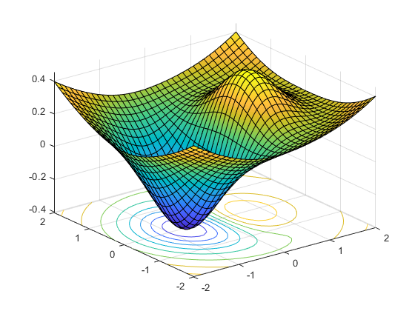
Gradient Descent
Compute the gradient
Update the parameters in negative gradient direction
Gradient
Now
$$L$$
$$W$$
Local Minimal

Slide 6
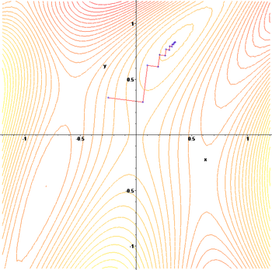
Update the Parameters Iteratively
Iteration $n$
$$W_{n+1}=W_{n}−ηL\left(W_{n}\right)$$
$η$: learning rate

Slide 7
Stochastic Gradient Descent (SGD)
Stochastic Gradient Descent
Batch Gradient Descent
Mini-batch Gradient Descent
batch-size=3
Training Set
Training Set
Training Set
Stochastic Gradient Descent
Batch Gradient Descent
Mini-batch Gradient Descent

Slide 8
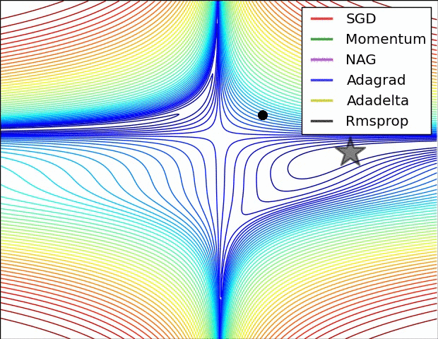
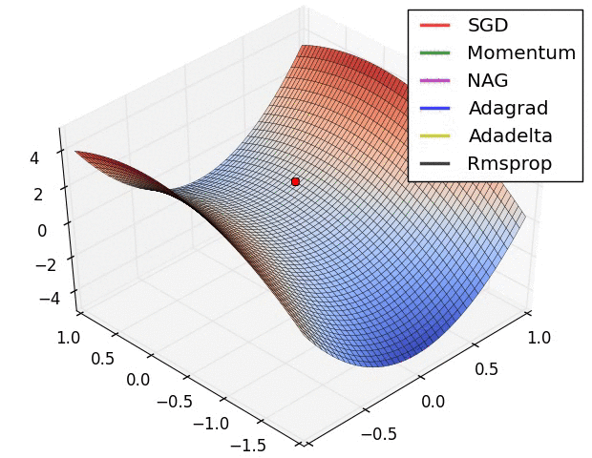
Gradient-based Optimization Algorithm
SGD
Momentum
Nesterov Momentum
Adagrad
RMSprop
Adam (2014)

Slide 9
Backpropagation - Forward Pass
$$L(W)$$
$$f(x;W_{f})$$
$$g(x;W_{g})$$
$$x$$
Input Data
$$\hat{y}$$
Loss
$$y$$

Slide 10
Backpropagation - Backward Pass
Chain Rule!
$$\frac{∂L}{∂W_{f}}=\frac{∂L}{∂W_{g}}×\frac{∂W_{g}}{∂W_{f}}$$
$$\frac{∂L}{∂W_{g}}$$
$$L(W)$$
$$f(x;W_{f})$$
$$g(x;W_{g})$$
$$x$$
Input Data
$$\hat{y}$$
Loss
$$y$$

Slide 11
Summary
Data preprocessing
Normalization
Linear classifier
SVM
Softmax
Loss function
Hinge loss
Cross-entropy loss
Regularization
Optimization
SGD
Backpropagation
Hyper-parameters
Validation/cross-validation

Slide 12
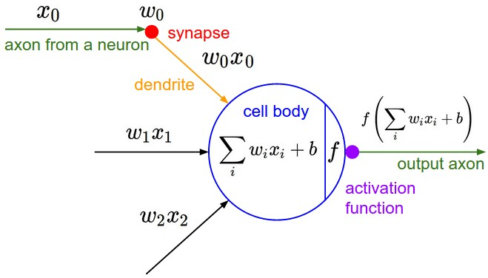
Neural Networks

Slide 13
Neural Networks as Neurons in Graphs
Fully-connected layer

Slide 14
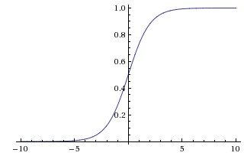
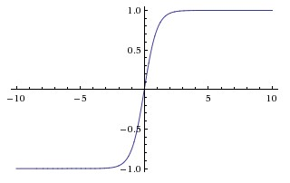
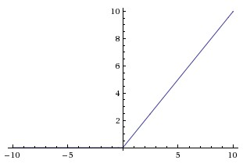
Commonly Used Activation Functions
Sigmoid
$σ\left(x\right)=\frac{1}{{1+e}^{−x}}$
Sigmoids saturate and gradient vanishing
Sigmoid outputs are not zero-centered
Tanh
$f(x)=\frac{e^{x}−e^{−x}}{e^{x}+e^{−x}}$
ReLU
$f\left(x\right)=\max\left(0, x\right)$

Slide 15
Convolutional Neural Networks
Convolutional Layer
Pooling Layer
Normalization Layer
Fully-Connected Layer

Slide 16
Convolutional Layer
Input image
Filter/kernel
2D-conv
Kernel size: 3x3
Output channel: 1
Stride: 1
Zero-padding

Slide 17
Convolutional Layer

Slide 18
Example: Convolve Without Zero Padding

Slide 19
Shape Computing
Shape of input feature maps $\left(W, H, C\right)$
Filters
Number of filters $K$
Kernel size $F$
Stride size $S$
Zero padding size $P$
Shape of output feature maps
$$\left(\frac{(W−F+2P)}{S}+1,\frac{(H−F+2P)}{S}+1, K\right)$$

Slide 20
Pooling Layer: Example

Slide 21
Pooling Layer
Max pooling
Average pooling
Min pooling
Adaptive {max, avg, min} pooling

Slide 22
Batch Normalization (2015)

Slide 23
Weight Initialization
Zero initialization
Normal
Xavier initialization (2010)
tanh
He initialization (2015)
ReLU

Slide 24
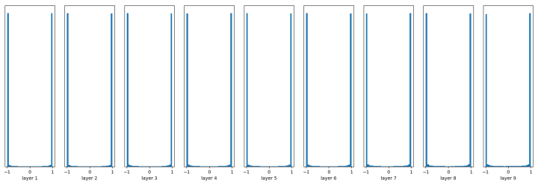
Weight Initialization - Normal Distribution
$$μ=0, σ=0.01$$
tanh
$$μ=0, σ=1$$
tanh

Slide 25
Weight Initialization - Xavier Initialization
tanh
ReLU

Slide 26
Weight Initialization - He Initialization
ReLU

Slide 27
ILSVRC
ImageNet Large Scale Visual Recognition Challenge
2010~2017
ImageNet
1.2 M images training set, 200 K images validation and test set
1000 categories

Slide 28
ILSVRC
Image classification winners
AlexNet (2012)
ZFNet (2013)
GoogLeNet (2014)
Inception-V4
VGGNet (2014 runner-up)
VGG-16, VGG-19
ResNet (2015)
ResNet-18, ResNet-34, ResNet-50, ResNet-101, ResNet-152
DenseNet (2016)
DenseNet-121, DenseNet-161, DenseNet-169, DenseNet-201

Slide 29
Transfer Learning
ConvNet as fixed feature extractor
pre-trained on ImageNet and fix parameters
remove the last fully connected layer and train it
Fine-tuning the ConvNet
pre-trained on ImageNet but don’t fix parameters
retrain all the model

Slide 30
Summary
Activation function
Convolutional layer
Pooling layer
Weight initialization
ILSVRC
Transfer learning

Slide 31
Reference
CS231n: Convolutional Neural Networks for Visual Recognition
http://cs231n.github.io/

